Slide 1
Plots
V.Adithya Krishnan

Slide 2
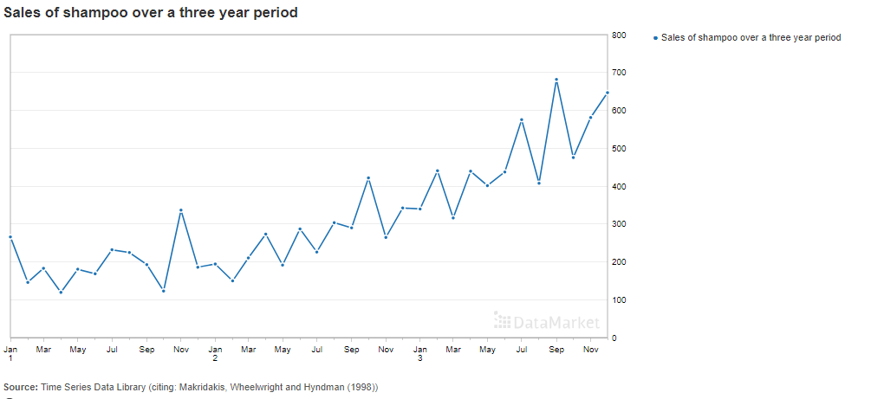
Dataset

Slide 3
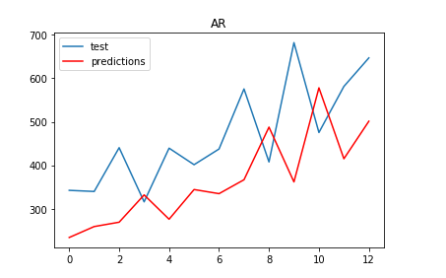
Results(shampoo dataset)
AutoRegressive model

Slide 4
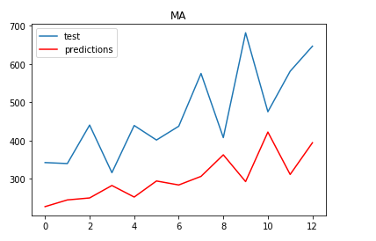
Results
Moving average model

Slide 5
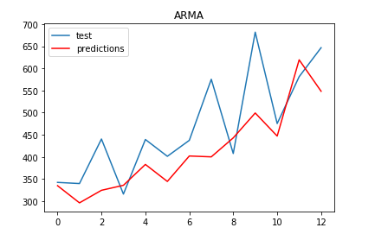
Results
ARMA model

Slide 6
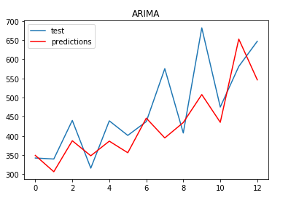
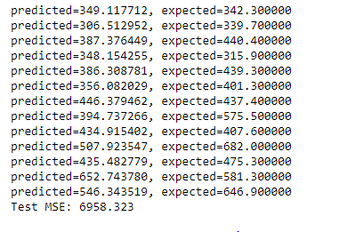
Results
ARIMA model (best parameter acc to Box-Jenkins)
p=5, d=1, q=0

Slide 7
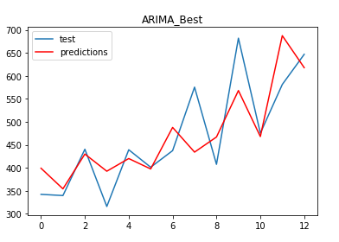
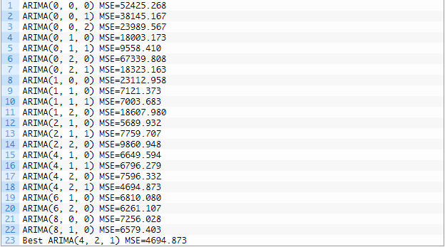
Results
ARIMA model (best parameter acc to Hyperparameter opt.)
Best Params(p,d,q) = (4,2,1)

Slide 8
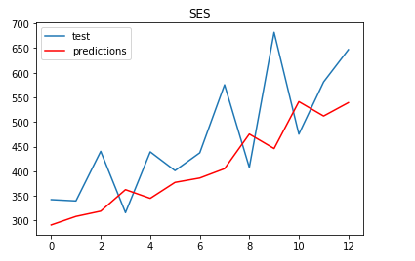
Results
Simple Exponential

Slide 9
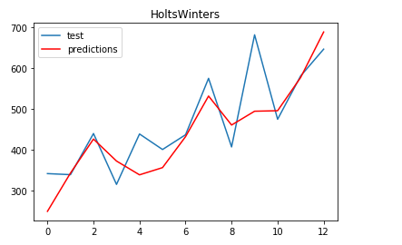
Results
HoltsWinters Exponential

Slide 10
Results(statistical)
All results are for Shampoo-sales dataset
Model | MSE
AutoRegression | 23113.207
Moving Average | 38145.267
ARMA | 7759.706
ARIMA | 6958.323
ARIMA (Best) | 4694.873
Simple Exponential | 10975.149
HoltsWinter (Best) | 5071.232

Slide 11
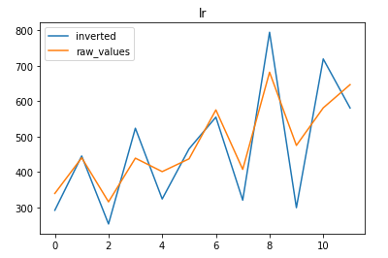
Results
LinearRegression model
RMSE: 89.038

Slide 12
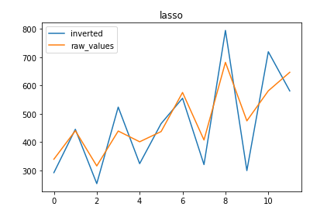
Results
Lasso model
RMSE: 89.021

Slide 13
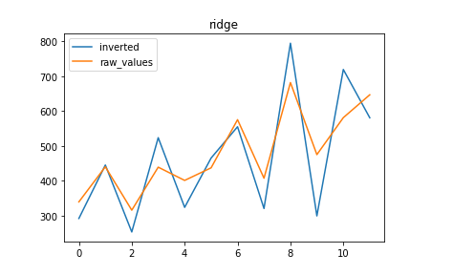
Results
Ridge model
RMSE: 89.038

Slide 14
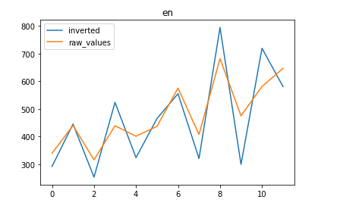
Results
ElasticNet model
RMSE: 89.024

Slide 15
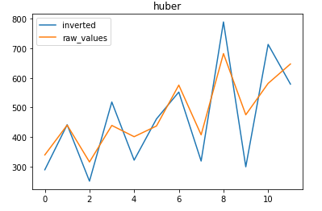
Results
Huber model
RMSE: 87.776

Slide 16
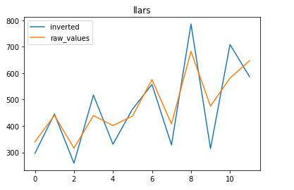
Results
LassoLars model
RMSE: 81.591

Slide 17
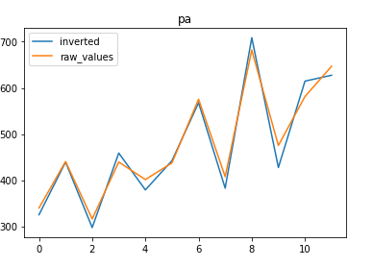
Results
PassiveAgressive model
RMSE: 23.555

Slide 18
Results(ML-Linear)
All results are for Shampoo-sales dataset
Model | RMSE
LinearRegresssion | 89.038
Lasso | 89.021
Ridge | 89.038
ElasticNet | 89.024
Huber | 87.776
LassoLars | 81.591
PassiveAgressive | 23.555

Slide 19
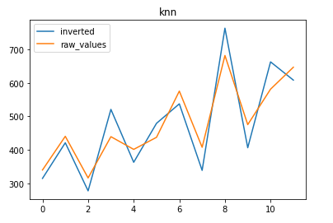
Results
Kneighbors model
RMSE: 56.397

Slide 20
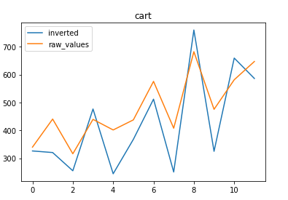
Results
DecisionTree model
RMSE: 98.548

Slide 21
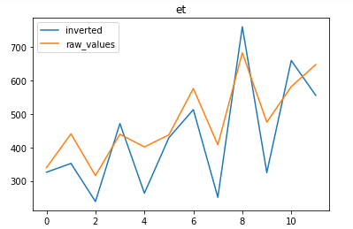
Results
ExtraTree model
RMSE: 109.479

Slide 22
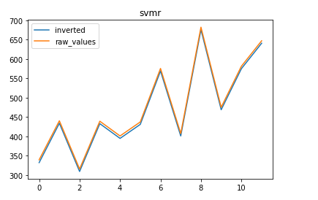
Results
SVR model
RMSE: 6.416

Slide 23
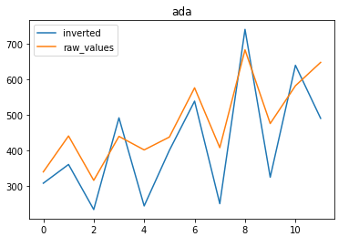
Results
AdaBoost model
RMSE: 101.204

Slide 24
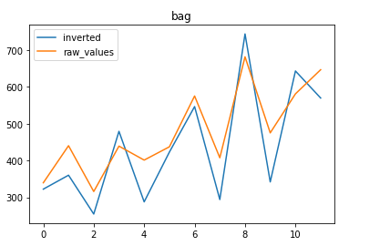
Results
Bagging model
RMSE: 76.525

Slide 25
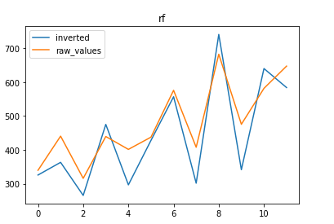
Results
RandomForest model
RMSE: 71.502

Slide 26
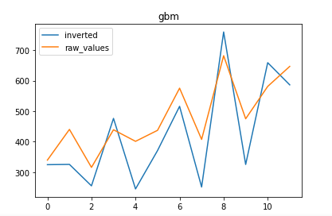
Results
GradientBoosting model
RMSE: 97.140

Slide 27
Results(Non-Linear)
All results are for Shampoo-sales dataset
Model | RMSE
KNeighbors | 56.397
DecisionTree | 98.548
ExtraTree | 109.479
SVR | 6.416
AdaBoost | 101.204
Bagging | 76.525
RandomForest | 71.502
GradientBoosting | 97.140

Slide 28
Thank You

